Slide 1
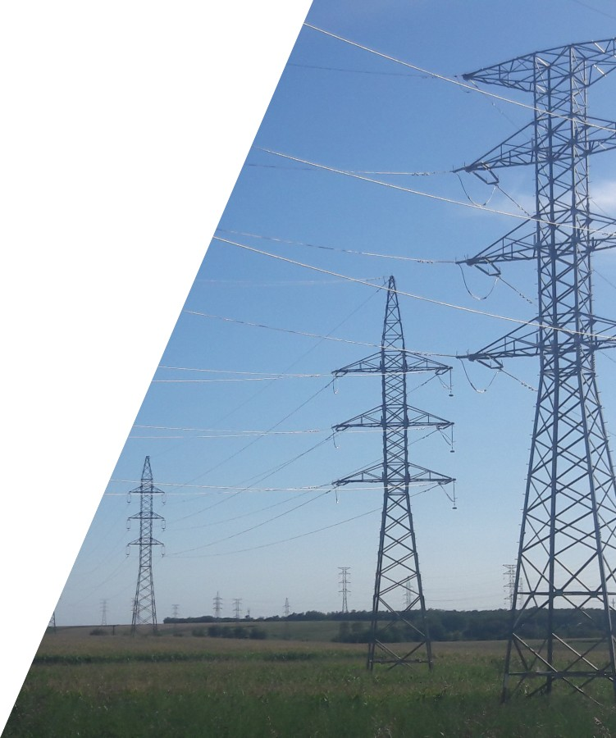
Installation issues, assembly
Várhelyi Alex
08.10.2025 Tokaj

Slide 2

Summary
1
Preparation
Assembly process, main steps
Issues
2
3

Slide 3
Preparation
1

Slide 4
Preparation
Line route surveys
Technical coordination meetings
Drum allocation
Uncovering of hidden defects
Assessing the condition of towers and foundations

Slide 5
Assembly process, main steps
2

Slide 6
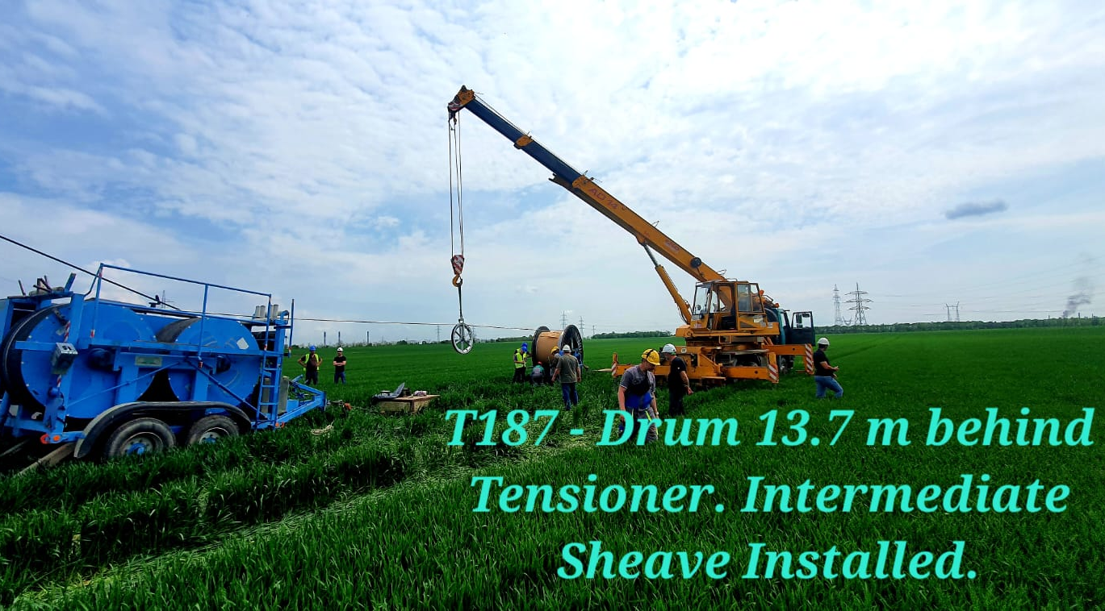
Assembly process, main steps
Placement of winch and drum sites
Sheaves sizes, and installations
Selection of pulling force and Speed
Sagging
Dead-end Assembly

Slide 7
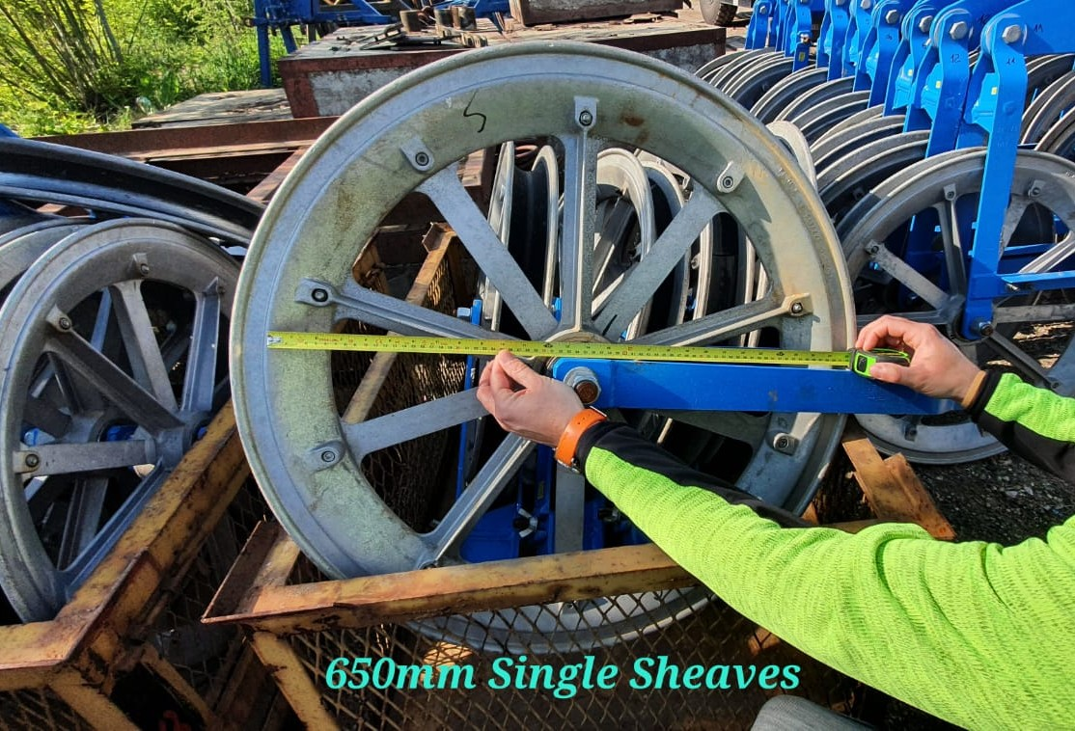
Assembly process, main steps
Placement of winch and drum sites
Sheaves sizes, and installations
Selection of pulling force and Speed
Sagging
Dead-end Assembly

Slide 8
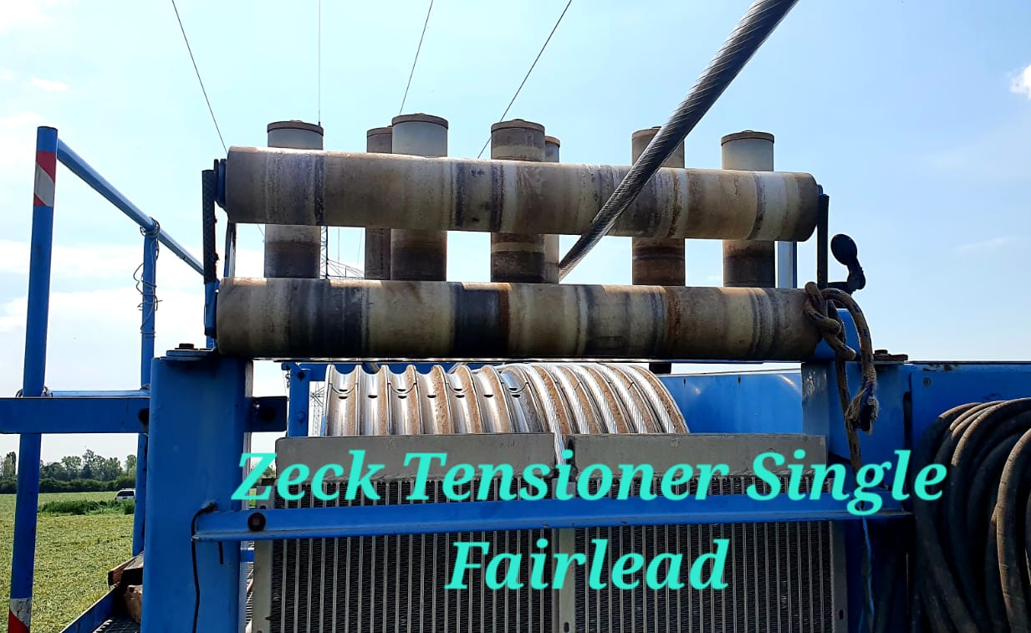
Assembly process, main steps
Placement of winch and drum sites
Sheaves sizes, and installations
Selection of pulling force and Speed
Sagging
Dead-end Assembly

Slide 9
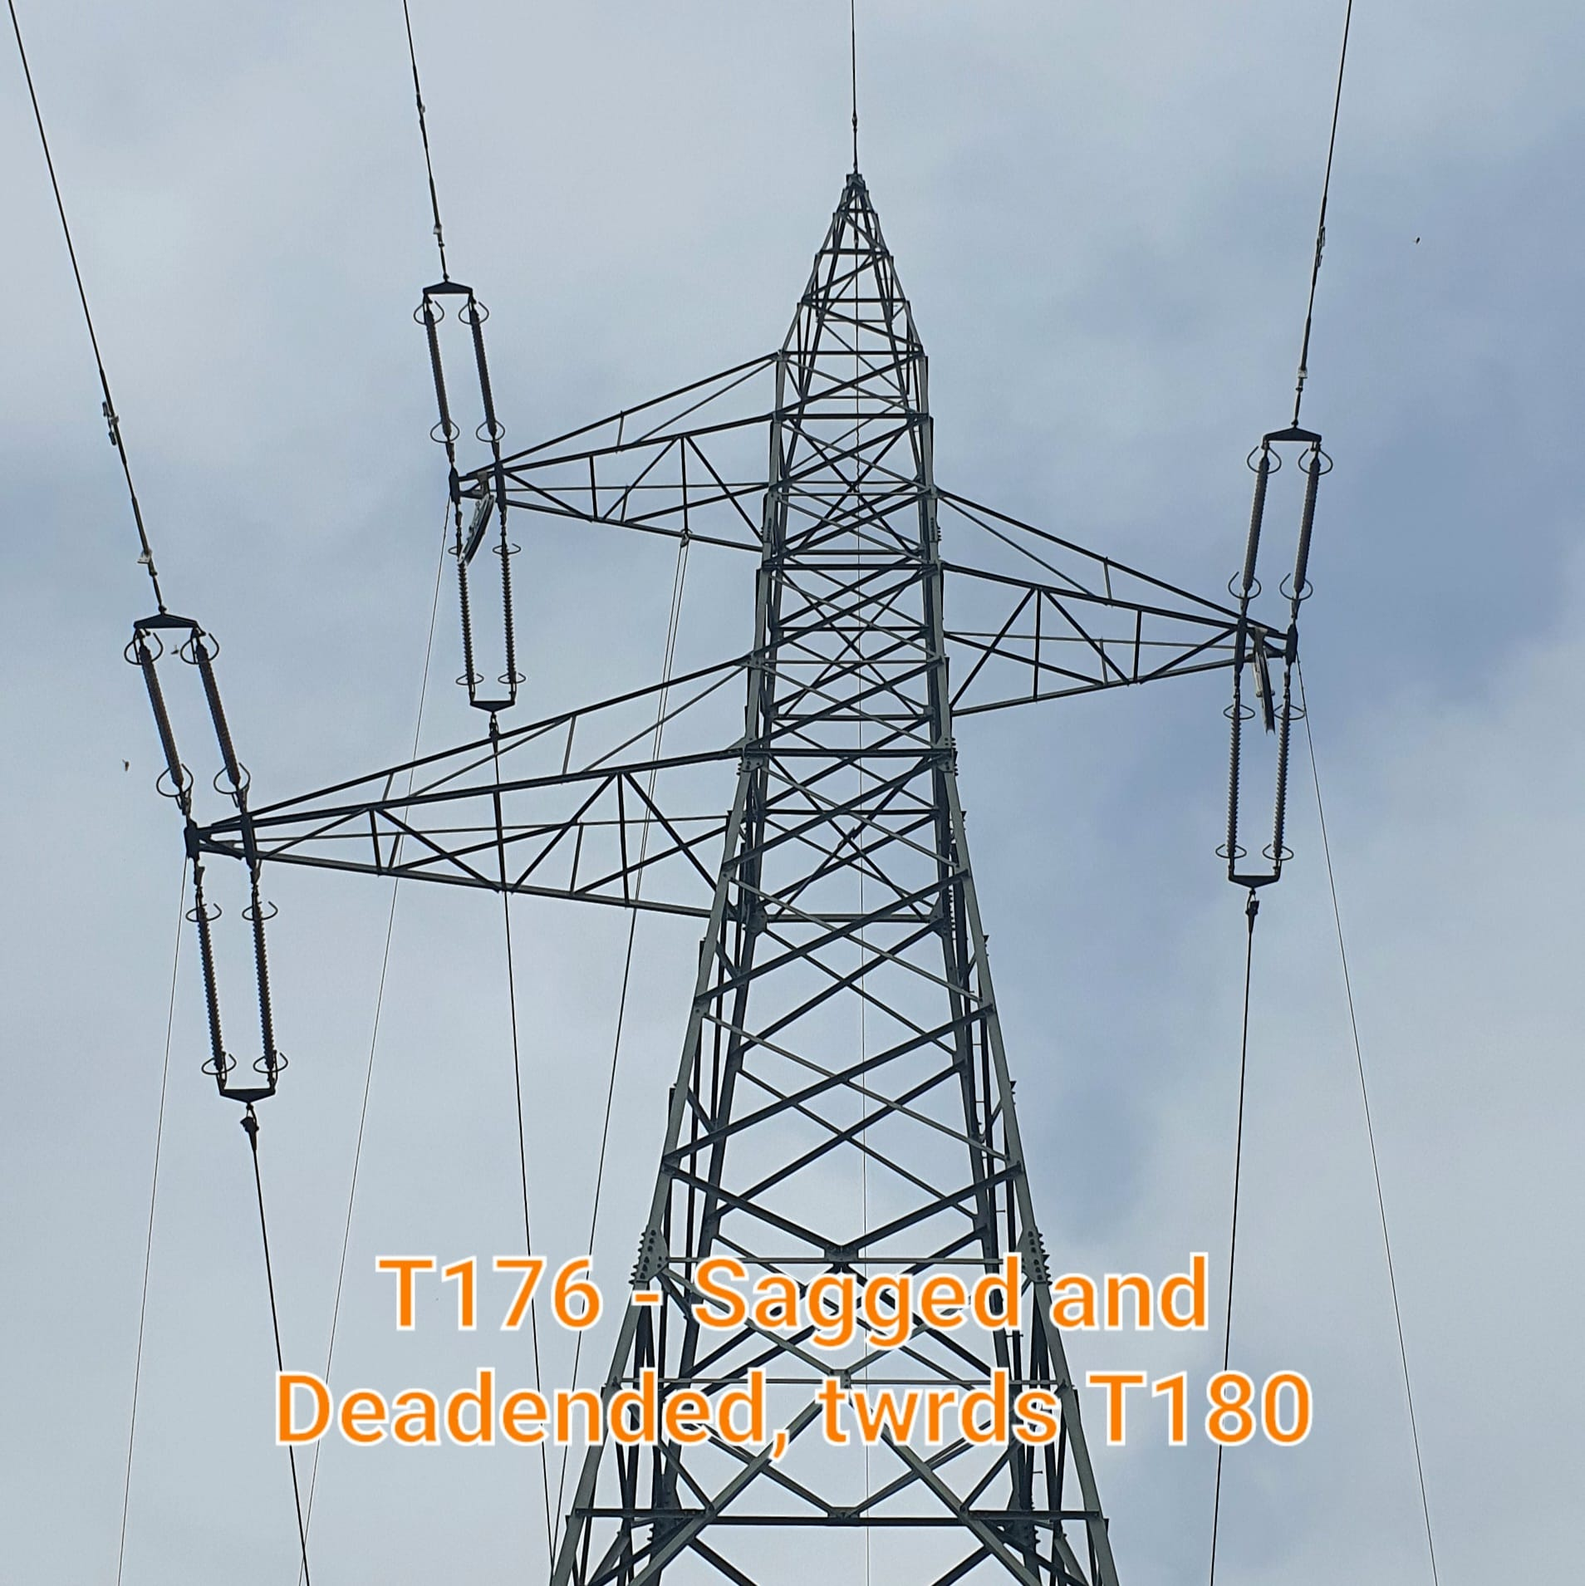
Assembly process, main steps
Placement of winch and drum sites
Sheaves sizes, and installations
Selection of pulling force and Speed
Sagging
Dead-end Assembly

Slide 10
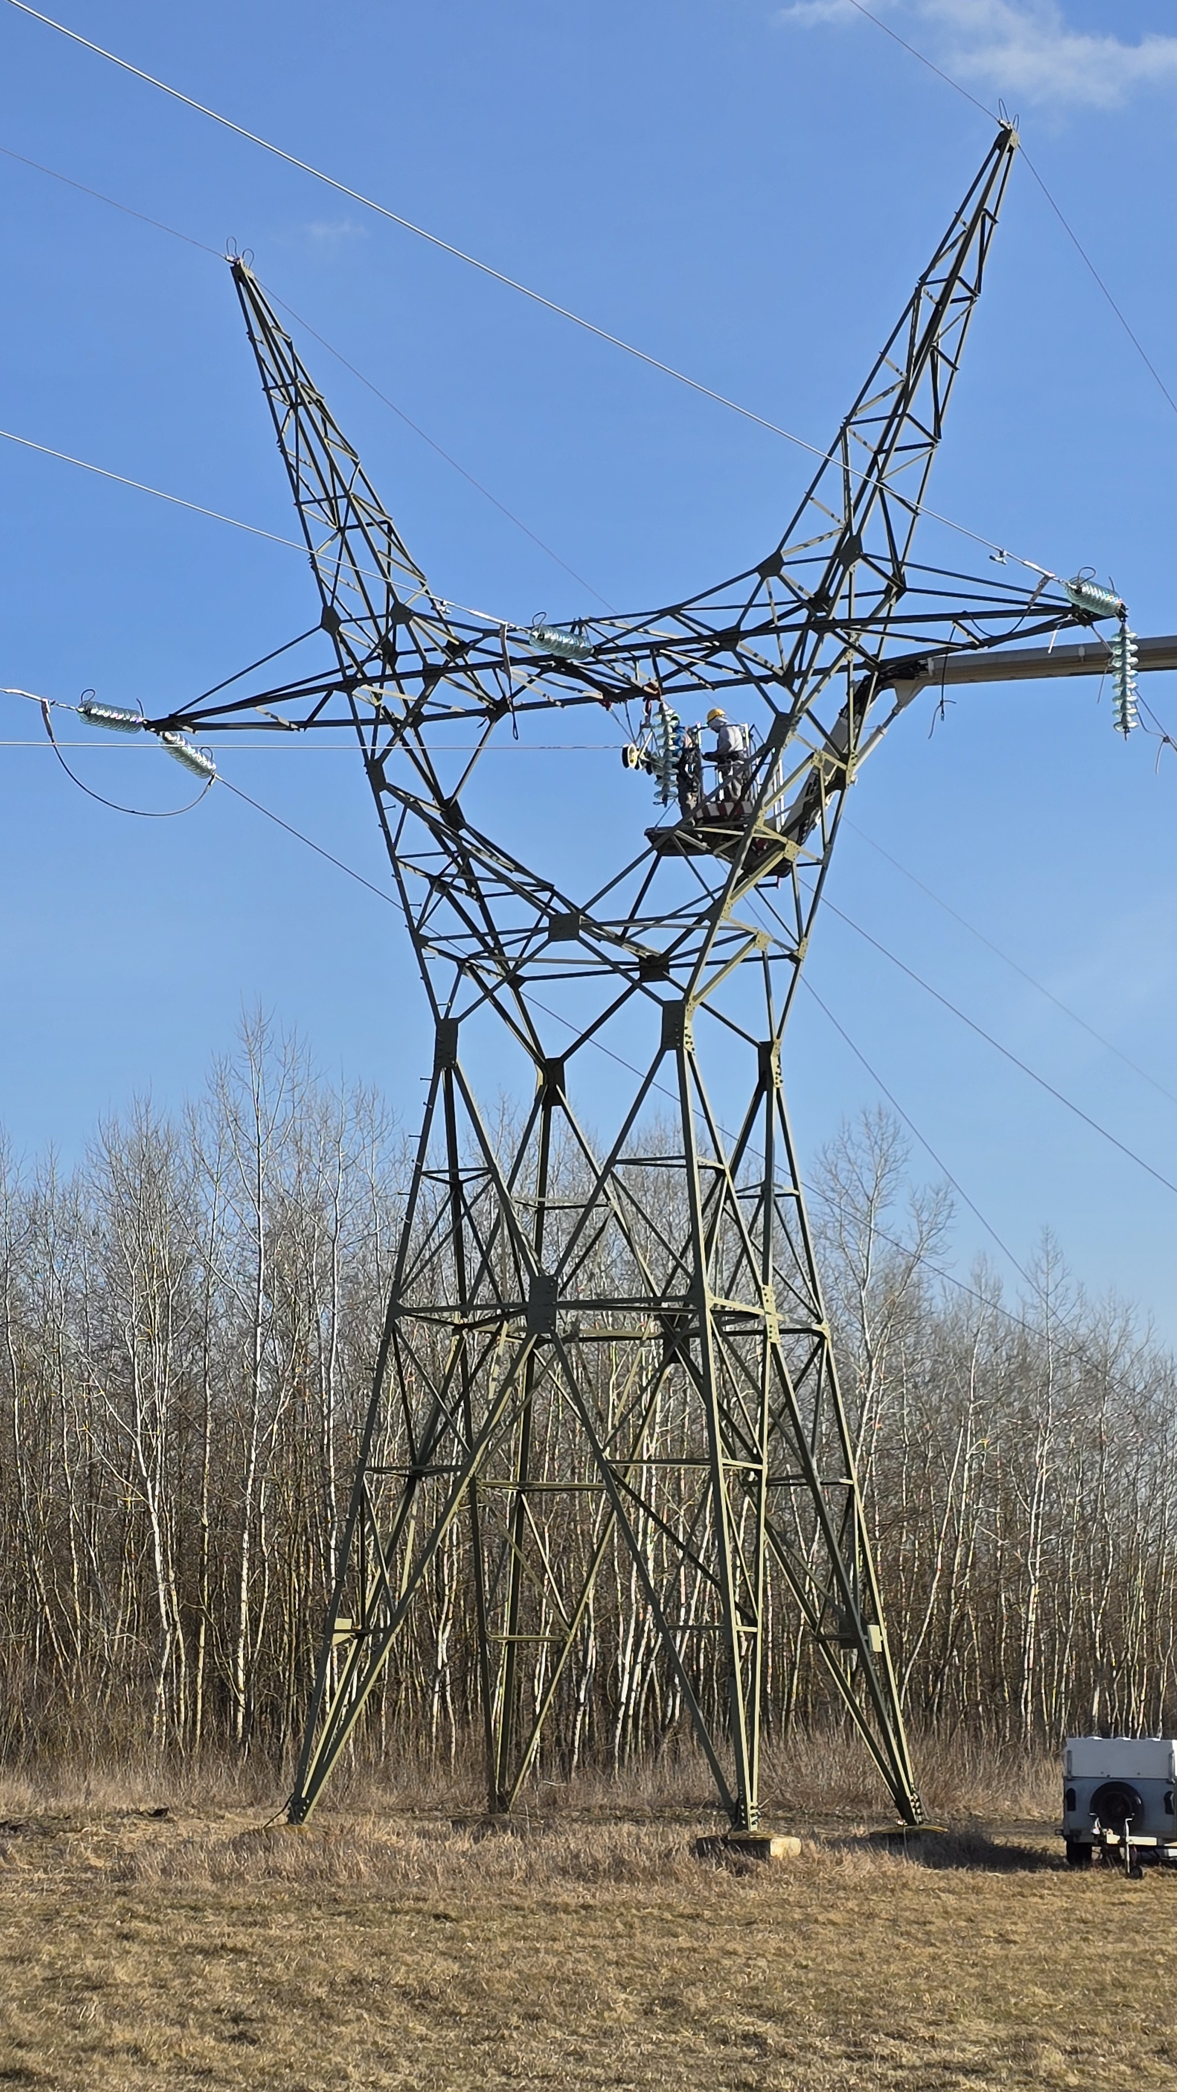
Assembly process, main steps
Placement of winch and drum sites
Sheaves sizes, and installations
Selection of pulling force and Speed
Sagging
Dead-end Assembly

Slide 11
Issues
3

Slide 12
Common problems During conductor replacement and installation
Transport, Loading, Storage
Project preparation and
7
ISSUES
De-energization
Installation issues

Slide 13
Common problems During conductor replacement and installation
Transport, Loading, Storage
Project preparation and
Inappropriate loading equipment or method
ISSUES
De-energization
Installation issues

Slide 14
Common problems During conductor replacement and installation
Transport, Loading, Storage
Project preparation and
ISSUES
Drum allocation, lack of schedule
Improper equipment placement
De-energization
Installation issues

Slide 15
Common problems During conductor replacement and installation
Calculation of resting time
Energizing conductor in deflection pulleys
Cutting Deadends, final adjustment
Transport, Loading, Storage
Project preparation and
ISSUES
Installation issues
De-energization

Slide 16
Common problems During conductor replacement and installation
Improper tool selection
Splicing conductors – making mid-span joints
Lack of static loads and anchoring
Problems caused by conductor handling
Problems arising from fittings and documentation
No InfoCore system
Transport, Loading, Storage
Project preparation and
ISSUES
De-energization
Installation issues

Slide 17
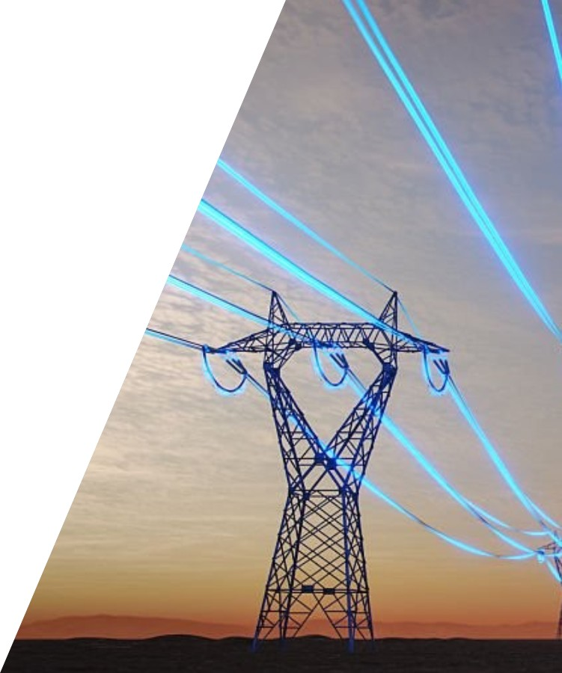
Thank you for your attention!
Várhelyi Alex
varhelyi.alex@mvmxpert.hu

